Slide 1
Inclusive Placement Opportunities for Preschoolers:
A Systems Approach to Preschool Inclusive Practices
A project of the Virginia Department of Education and the Technical Assistance Centers of Virginia

Slide 2
Module 8:
Performance Monitoring in Inclusive Early Childhood Settings
Notes:
Presenter:
Briefly explain why measuring and monitoring children’s performance/progress in our early childhood programs is crucial for planning and development. It will help to shape not only how and what we teach but also help us to know our children better.
If the the picture is “business looking” for early childhood presentation, it can be changed out.

Slide 3
Learning Objectives
Participants will…
Understand the difference between Tiers 1, 2 and 3 Instructional Support
How to organize and analyze data to in order to make informed decisions that affect instruction.
How to identify needs based on a tiered system of supports
Notes:
Presenter will share the learning objectives for this module with the participants.

Slide 4
Designing and Implementing Curriculum Framework for ALL Children
Professional Development
Grisham-Brown, Hemmeter, & Pretti-Frontczak, 2005
Notes:
Presenter:
It all starts with designing and implementing a curriculum framework. Performance/Progress Monitoring is just one crucial piece of the umbrella.
This is where we monitor the effectiveness of the instruction across all three tiers. For the purpose of this module, we will only be looking at this one component of the Curriculum Framework

Slide 5
“DATA” IT’S NOT A FOUR LETTER WORD!
Notes:
Presenter:
Start from the simplest form of assessment.
This presentation is about using both data and assessments to assess, collect data, and drive goal development and student outcomes.
“Data” is often a dreaded word for many reasons. In the past goals were more subjective based on what we observed in the classroom/therapy room. Data was taken but not properly analyzed. Since using a curriculum based assessment, we are able to have more objective information and collaborate with team members to prioritize goals. (Areas of AEPS) We created a common data collection form so that it is consistent.

Slide 6
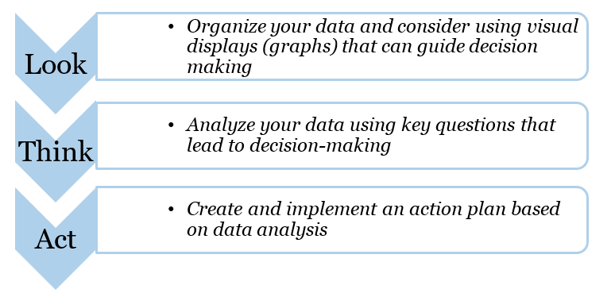
Using Your Data
Notes:
Presenter:
When Using and Organizing your data, use this Look, Think, Act Model to help when using a process of working with any data that you collect.
Talk through this model as it is written on the slide, filling in points with personal examples from the presenter who is using the slides. Refer to the PDF link below. Pass out handout if this is helpful. It is in the handout section of this module.
The material comes from ECTA & NCPMI’s Look-Think-Act data decision making process.
1. Look – Examine data for trends, meaningful associations
2. Think – Ask questions related to the data that might help with interpretation
3. Act – Make decisions as a team and identify the action plan needed to put the decision in place
Here is the direct link: https://ectacenter.org/~pdfs/sig/5_3_lta_introduction.pdf

Slide 7
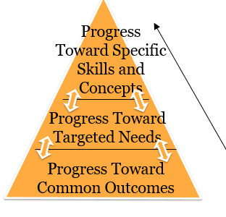
Performance Monitoring, Slide 1
Performance monitoring varies in:
frequency,
intensity,
and intent.
Used to Revise Activities and Instruction
Notes:
Presenter:
The data that you collect will vary depending on what you need to know. You may be familiar with this pyramid and Tiered System of Support.
Talk through this picture, explaining that the progress toward outcomes becomes more intense and concentrated/targeted as the needs of the student are more selective as you go up the pyramid, going from Tier 1 to 2 to 3.

Slide 8
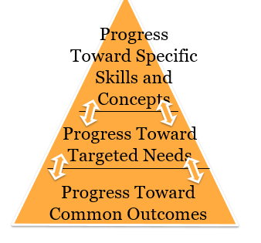
Performance Monitoring, Slide 2
Collect systematic data on individual skills for particular children using counts and tallies, written narratives, and/or permanent products
TIER 3: Intensive Instruction
TIER 2: Targeted Instruction
Repeated administration of targeted probes that emerge from CBA
TIER 1: Universal Instruction
Re-administer CBA originally conducted to obtain baseline
Notes:
Presenter:
Similarly, the assessment tools that are administered and the frequency at which they are administered, will also depend on the needs of the children. and will need to be paired with the instructional needs.
According to the this diagram, the CBA will need to be re-administered to assess progress toward common outcomes. Repeat administration of target probes that emerge from CBA for your tier 2 outcomes. Collect data on individual skills for particular children using counts, tallies, etc. toward individual outcomes for your tier 3 outcomes.

Slide 9
Performance Monitoring, Slide 3
Minute by minute, hourly, daily, weekly
TIER 3: Intensive Instruction
TIER 2: Targeted Instruction
Weekly, bi-weekly
TIER 1: Universal
Instruction
Annually, semi-annually, quarterly
Notes:
Presenter:
This slide gives a description of how often we need to take data, according to the tiers. One way to think about is to is to compare it to how often we spend and check our money. With our expenses, how often do we need to take “data”?
Inverted pyramid
How often do we...
Tier 1 – check our retirement account, (Annually or twice a year)
Tier 2 – check and pay monthly bills, get gas check our bank account (weekly and Monthly)
Tier 3 – grocery store, trips to Starbucks (Daily or several times a week)

Slide 10
Types of Data Quantitative vs. Qualitative
Quantitative
-There are 5 trees
Qualitative
-The trees have yellow and red apples
Notes:
Presenter:
Now we are going to switch gears and talk a little bit about the difference between Quantitative data vs. Qualitative data
Quantitative data are measures of values or counts and are expressed as numbers. Quantitative data are data about numeric variables (e.g. how many; how much; or how often). Qualitative data are measures of 'types' and may be represented by a name, symbol, or a number code. They are descriptive data.

Slide 11
Types of Data: Qualitative and Quantitative
Narrative
Anecdotal Notes
Strength statements
Emerging skill statements
Areas of concern statements
Permanent Products
Numerical
Total numbers or Percentages
Tallies
Duration
Checklists
Rating scales
Visual
Graph
Chart or table
Notes:
11
Presenter:
Here is one resource that you can learn more about types of data. This book goes into more detail about the types of data that can be collected in the classroom and what it can be used for.
We will take a look at some of these types of data/assessment methods in the slides ahead and the purpose for using those types of data. Review these types of Data that are listed on the slide. You can ask participants to give examples of how they are collecting data and using it in their classroom.
11

Slide 12
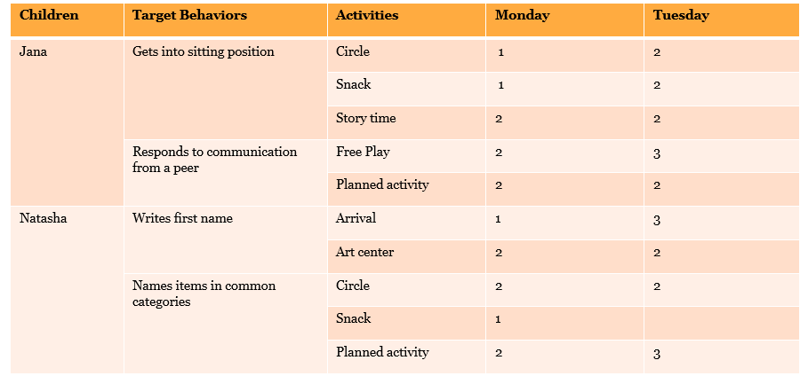
Data Matrix 1=model or assistance, 2=gesture prompt, 3=independent
Notes:
Presenter:
Here’s an example of a data Matrix chart with quantitative data that records the following behaviors:
Getting into sitting position
Responding to communication from a peer
Writing first name
Naming items in common categories
for 2 children, and notes whether or not the child needed assistance, model, a gesture or could do it independently.
Also it is noted where the activity took place.
Activity: Turn to a shoulder partner and tell them what can you glean from this Data Matrix about either Jana and/or Natasha and their level of independence during Circle time, and choose a targeted behavior, such as Names Items in Common Categories OR Gets into Sitting Position.. Then have pairs share out to the large group.
Answers might include: child needs increasing gestures/prompts or needed no prompt from Monday to Tuesday. Ask follow up questions such as “how can you plan for this? What supports can you put into place to ensure that child is becoming more independent?”
Is this an effective means of collecting data?

Slide 13
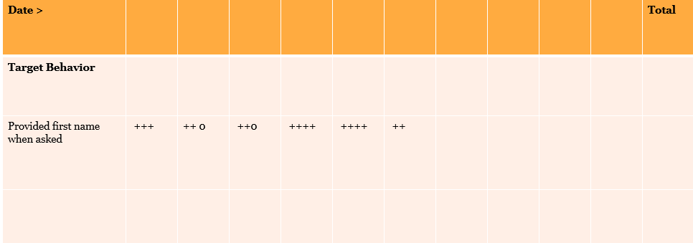
Data Collection Sheet
+ = Performed Independently
O = Did not perform
Student’s Name: __________Week:___________
Notes:
Presenter:
Here’s another example of a data collection sheet. A simple talley recording sheet of + and -’s with the target behavior stated beside: “Provided first name when asked”
How does this compare to the Matrix?

Slide 14
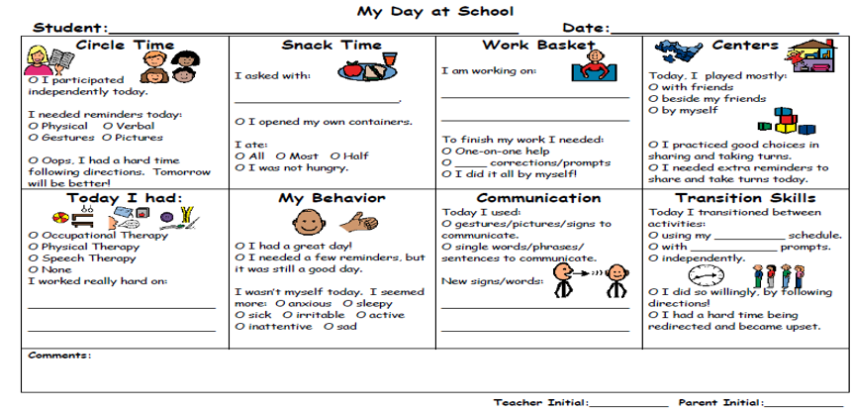
Data Summary Sheet Example
Notes:
Presenter:
Here is an example of a combination of qualitative and quantitative data summary sheet that could be copied and sent home daily on a child’s day at school.
Have you used something like this in your classroom? Has it been returned?

Slide 15
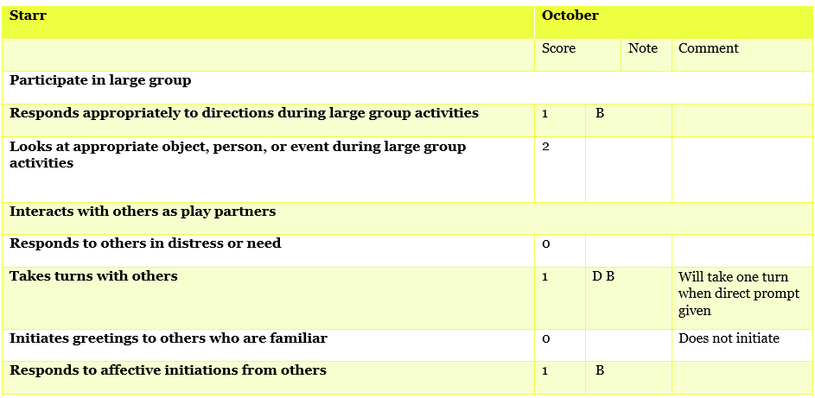
Mrs. Donovan
Notes:
Presenter:
Refer to handout (in the handouts section of this module): Performance Monitoring Case Study.This is Starr’s AEPS score sheet At your table or in small groups, take a look at this data,
Activity:
-Determine a goal for Starr based on the October assessment results.
-Next, determine the data collection methodology to use. How often would you collect data on this skill?
Ratings
2 = Child independently and consistently met item criteria
1 = Child partially met specified criteria, child needed assistance, child inconsistently performed the criteria, and/or, the child’s performance toward the criteria was emerging
0 = Child was not yet able to perform or meet the stated item criteria
Notes
Q = Quality of the Child’s performance is a concern
B = Child’s behavior interfered with his/her performance
D = A Direct Prompt was needed for the child to perform the task

Slide 16
What is Analysis?
Notes:
Presenter:
What is Analysis? Why is analysis important for monitoring performance of students data? What can you learn?
presenter can either take participants answers and write them down on chart paper or just discuss them as a large group

Slide 17
Convert to Percentages
Notes:
Presenter:
During the analysis stage, important to convert the data to percentage in order to plot it on a graph so that you can measure growth.
This is one way to look at how you can look at growth.

Slide 18
Which is more helpful?
Notes:
Let’s analyze this data together. Looking at the two charts. What type of data would help us? Which chart would be better in terms of comparison of looking at the % of AEPS items achieved, emerging and not yet demonstrated VS # AEPS items of the same.
Why does the second set set of data give you more information versus the first set?
Let the participants give their answers either as a whole group or this could be a PAIR and SHARE activity.

Slide 19
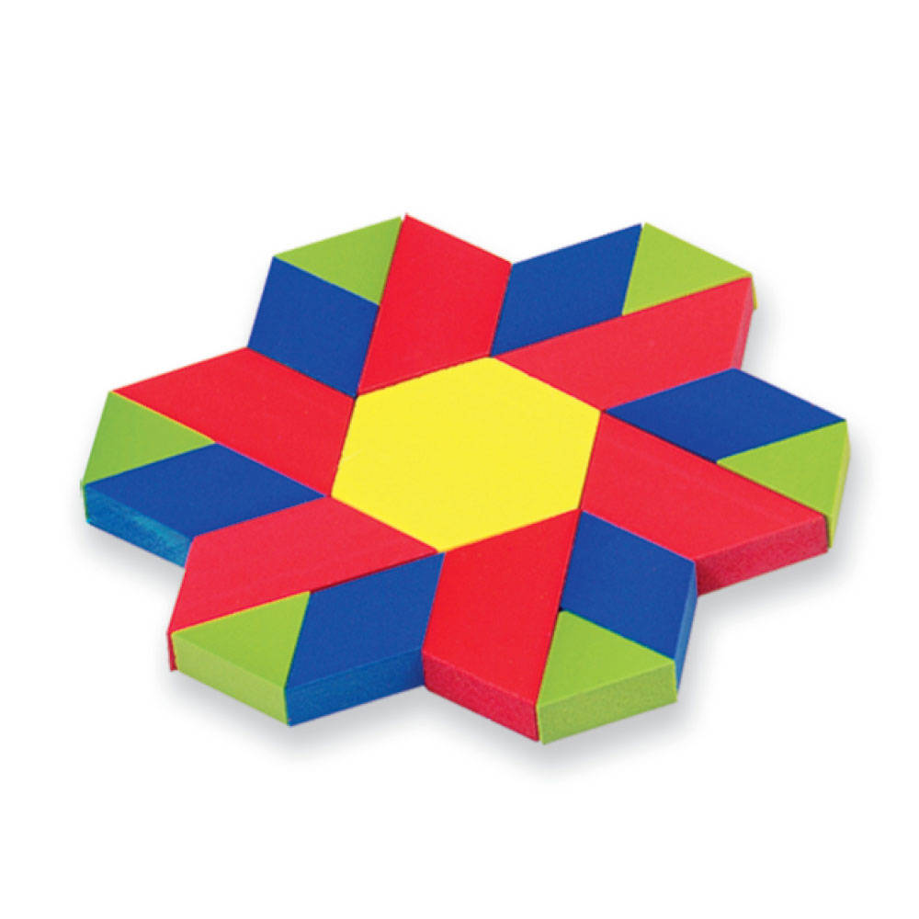
Identify Patterns
Strengths
Lack of Quality
Assistance / Prompting Required
Behavior Interference
Unexpected Scoring Sequences
Notes:
Presenter:
In general, teachers should look for patterns regarding when children are successful, which toys/activities/people they like to engage with, when they need assistance, when they are able to do something functional but the quality of their performance is poor and when challenging behaviors such as acting out are likely to occur.

Slide 20
Find the Patterns
Mrs. Donovan took data during three activities (small-group centers, large-group circle, and outdoor play). She reviewed Starr’s performance. She documented when Starr initiated a greeting or a cooperative activity.
 | Circle | Small-group or Centers | Outside
11/10 | _ | ++ | _
11/17 | +++ | _ | _
11/24 | _ | +++ | _
12/1 | ++++ | +++ | _
12/8 | _ | ++++ | _
Notes:
Presenter:
Have participants refer to page 2 at the second half of the case study. Look at the pattern. What patterns do you notice about Starr’s ability to initiate a greeting during these routines/activities of the day?
Note: On handout, the middle column should read Small Group OR Centers.

Slide 21
Visually Analyze
Trend (up, down, or same)
Mean (average performance)
Variability (peaks and valleys or stable)
Change in level
Latency (how long it takes)
Notes:
Presenter:
As we’re analyzing our data, we’re also looking for trends. For example, if the number of times a child cries when asked to put toys away decreases due to our instruction, a downward trend is observed. We’ve done something right.
You can also look at data by comparing a child’s score with the mean of a group. We can look for whether the score varies based on times of day or who is working with the child. Is there a change in level or intensity of the skill during certain times and we also want to track things like latency or how long it takes the child to perform the skill when asked.

Slide 22
Analyze
 | % of time engaged | % of time engaged | % of time engaged | % of time engaged
Starr | 25 | 33 | 36 | 25
Rosa | 48 | 52 | 56 | 58
Notes:
Presenter:
Continue working from the case study. After reviewing the AEPS scores, Mrs. Donovan identified another goal for Starr and for Rosa. They will work on engagement.
Mrs. Donovan began providing instruction on the goal and collected data twice a week. Data is collected during small group centers (this may need to be defined as one activity rather than either or for the sake of this activity. Doesn’t matter which. Either Small Group OR Centers).
Mrs. Donovan would like for Starr and Rosa to be engaged 80% or more of the time. After several weeks of instruction, Mrs. Donovan takes a close look at the data.
After reviewing the AEPS scores, Mrs. Donovan identified another goal for Starr and for Rosa. They will work on engagement.
Mrs. Donovan began providing instruction on the goal and collected data twice a week. Data is collected during small group centers. Mrs. Donovan would like for Starr and Rosa to be engaged 80% or more of the time. After several weeks of instruction, Mrs. Donovan takes a close look at the data.
Activity:
-Review (analyze) the data outlined in the table. Analyze the data and provide a summary.
-Based on the data, would you make any changes to Starr’s instruction? To Rosa’s?
Are you missing any data? What else do you need to make further decisions?

Slide 23
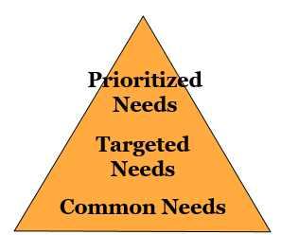
Let’s Review….
From assessment summaries, determine children’s needs that fall across three tiers.
WHO needs to learn WHAT?
Notes:
Presenter:
Up until now, we have been using our pyramid model when referring to Common, Targeted and Prioritized Outcomes for Children. Now, we’re going to shift and keep that same tiered model in mind but think in terms of needs as we answer the following questions.
Ask a participant to explain what the components are of each area. They can use the next slide, as guiding questions.

Slide 24
Sort and Prioritize
What skills can be addressed through development, play, maturation, and exposure/experience?
What skills are emerging, need practice and repetition?
What skills and concepts are unlikely to emerge without intensive instruction?
Notes:
Presenter: Ask the participants: First we’re going to identify needs, who needs to learn what?
These questions can be asked out to the group, see below (the questions can also be listed out of sequence)
What skills can be addressed through development, play, maturation, and exposure/experience?
(Tier One)
What skills are emerging, need practice and repetition?
(Tier Two)
What skills and concepts are unlikely to emerge without intensive instruction?
(Tier Three)

Slide 25
Tier 1 Needs
What common concepts and skills are covered/taught/addressed?
State standards
Federal outcomes
Adopted curriculum objectives
Items from assessment
Notes:
Presenter:
Review the Common Needs on the slide. Tier 1 or Common Needs are driven by Child’s Needs, based on missed items from assessment as well as that which is common to state and federal standards/outcomes-language & math requirements
Self-regulation and following routines. These are going to be generic needs across the board in every classroom.

Slide 26
Tier 2 Needs
What related skill/concept is needed?
Most often emerging skills (stalled but not missing)
Concurrent skills/concepts
Components or portions of the larger skill that are missing
Notes:
Presenter: Review the targeted needs on the slide.
Tier 2 or Targeted Needs are needs that are more specific to a smaller group of children
-portions/components of a larger skill that are missing.
Example: Child who is able to greet a peer but not a large group setting or using a 3 turn exchange because the environment is too overwhelming for him. The Targeted Skill that is missing or still needed is the social language (pragmatic) piece and generalization.

Slide 27
Tier 3 Needs
Concepts and skills that are keeping the child from ACCESSING, participating, and making progress in the general curriculum and daily activities.
Examples:
-Barriers or underlying issues or concerns (challenging behavior, quality of movement, another language)
-Foundational or prerequisites (joint attention, imitation, vocalization, functional use of objects)
Notes:
Presenter: Review the prioritized skills on the slide
Tier 3 or Prioritized Needs are the concepts and skills that are keeping the child from accessing, participating, and making progress in the general curriculum and daily activities.
After the needs of individual children or groups are sorted, teachers may find that several children have many tier 2 and tier 3 needs or even that a single child has many such needs. Prioritize where to begin. Choose the RIGHT KEY based on what will open more that one developmental door, what is a priority of the family, what is next in the developmental sequence. It’s the gateway skill!
Choose functional skills first: Skills that
promote independence,
can be taught in multiple settings,
can be used in real life,
are priorities for the family.
Life becomes easier if you’ve written good IEP goals that address prioritized needs.

Slide 28
Identify Tier 1, Tier 2 and Tier 3
Engaging in Cooperative Activities
Vocabulary
Notes:
Presenter:
Activity: This can either be a Turn, Pair and Share or participants can work at their tables: (Make sure that participants have markers, post-its, chart paper if you want them to report out to larger group.)
What can you gather from this data in these two categories about these three students? Do you need additional information?
What types of activities could you build into their day to help strengthen either their ability to engage in cooperative activities and/or Vocabulary development? Whatever needed to be worked on.

Slide 29
Other Considerations
Family
Goals prioritized by the family
Transition
Is child nearing an important transition (e.g., into kindergarten) and what skills are needed there?
Participation
Can the student fully participate in the activity?
Engagement
Is the child engaged in learning?
Interfering Behavior
Does the child have self-regulation skills?
Does the child have effective communication skills?
Notes:
Presenter:
There are other factors to consider beyond just data. Data is what we are talking about, but it will be good to let the participants know of other things to look at. – Use a common sense approach ☺
The final bullet on participation/engagement is to really get them thinking…what does this mean? The child should be able to meaningfully participate in all activities in the EC classroom. If not, perhaps something else is contributing to this and needs to be looked at much more closely.
This could lead into a much deeper discussion, so be aware of the remaining time you have with your participants to delve into this topic.

Slide 30
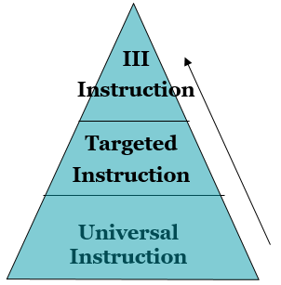
Activities and Instruction
Key words: individualized, longer duration, high intensity, intentional
Type of activities and instructional strategies vary in frequency, intensity, and intention
Key words: targeted, increased dosage and intensity
Key words: all settings, all students, preventive, proactive, core
Notes:
30
Presenter:
Share out that in similar format to our outcomes and needs, this slide shows us that the tiered systems can also be used for instruction, as shown. Remember that the instruction is tiered, not the students. Go over this slide in detail, as the next slide the participants will have to fill in the boxes on their own.
Universal – DAP, VA Foundation Blocks for Early Learning- All Settings, All Students, Preventative, Proactive, Core
Targeted – small group, extra opportunities, intentional planning- Targeted, Increased dosage and intensity
Intensive – one-on-one, intentional, frequent- Individualized, longer duration, high intensity, intentional

Slide 31
Identify the Activities and Instruction
Type of activities and instructional strategies vary in frequency, intensity, and intention
Notes:
31
Presenter:
Ask the following question: Can you fill in the blanks from the slide above from the 3 tiers? See below in italics. This be done as a group or in a turn, pair and share with a shoulder partner activity.
Universal – DAP, VA Foundation Blocks for Early Learning- All Settings, All Students, Preventative, Proactive, Core
Targeted – small group, extra opportunities, intentional planning- Targeted, Increased dosage and intensity
Intensive – one-on-one, intentional, frequent- Individualized, longer duration, high intensity, intentional

Slide 32
Changes
Change the behavior targeted
Change the selected antecedents (what happens before the behavior targeted)
Change the feedback/consequences
Change the accommodations or modifications
Change how often learning opportunities are provided
Change where learning opportunities occur
Change the instructional strategies
Notes:
Presenter:
This slide talks about changes. Talk about the potential for change and what can happens next. How can you affect change in the outcomes that you want? Be mindful of the factors that you change and the skills that you want to target. Generate some group discussion.

Slide 33
Now, Let’s Think about YOUR Students
Consider the group of children you taught this past school year
What assessment data did you collect?
What other data did you collect?
What skills did the majority of them need to know?
What skills did a small group of them need extra help with?
What (2-3) skills did individual children need intensive instruction on? How were you able to provide that level of instruction for them?
Notes:
Presenter: This could be a wrap up/final activity.
Ask the questions on the slide and have participants look at the types of data sheets that they could use or did use throughout the year with their students to collect data.
How did you target the IEP goals that you needed to collect data on during the day?
How did you make it manageable for you and your assistant?
How did you analyze the data and make decisions based on the outcome of the data?
What would you do differently? the same? This could be worked into the Exit ticket, or into group discussion.
Using an Exit Ticket Handout, answer the following questions:
What 3 three positive things did you learn from this module
How will you start to look at data differently
How will you use the data that you collect differently in your classroom (for what purpose)?
How will you share this information with others?

Slide 34
Resources, Slide 1
▶Grisham-Brown, J., Pretti-Frontczak, K. (2011) Assessing Children in Blended Programs. Baltimore: Paul H. Brookes
▶Bagnio, Neisworth, Pretti-Frontczak (2010) LINKing Authentic Assessment and Early Childhood Intervention: Best Measures for Best Practices by NAEYC Developmentally Appropriate Practices in Early Childhood Settings. Baltimore: Paul H. Brookes
▶ ECTA website: Screening, Evaluation and Assessment
http://ectacenter.org/topics/earlyid/screeneval.asp
Notes:
Resources Slide

Slide 35
Resources, Slide 2
▶ECTA website: Improving Systems, Practices and Outcomes-Performance Checklists
http://ectacenter.org/decrp/type-checklists.asp
▶Data Decision Making Tools http://challengingbehavior.cbcs.usf.edu/Implementation/data/index.html
▶ECTA & NCPMI: Look-Think-Act https://ectacenter.org/~pdfs/sig/5_3_lta_introduction.pdf

Slide 36
Thank You!
If you have any questions about the content in this module or need further assistance implementing a systems approach to early childhood inclusive practices, please contact the early childhood staff at the following T/TACs.
Regions 1&8 VCU 804-828-6947 or 434-292-3723
Regions 2&3 ODU 757-683-4333
Region 4 GMU 703-993-4496
Region 5 JMU 540-568-6746
Regions 6&7 VT 540-231-5167

